Slide 1


Online Retail Business Insights
BY:
Yaaz Shaikh

Slide 2
Agenda
Data Preparation & Cleanup
CEO Insights
Monthly Revenue Trends
Global Market Demand
CMO Insights
Top Performing Countries
Top Customers by Revenue
Recommendations

Slide 3
Data Preparation & Cleaning
Removed invalid records (UnitPrice < 0, Quantity < 1)
Filtered out blank CustomerIDs
Created DAX Measures:
Total Revenue = Quantity * UnitPrice
Unique Customers
Total Orders
Avg. Order Value
Added Date Table for time intelligence

Slide 4


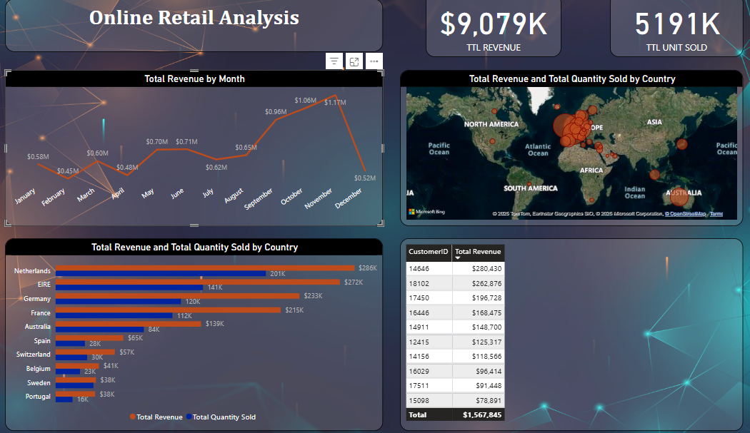
OVERVIEW

Slide 5
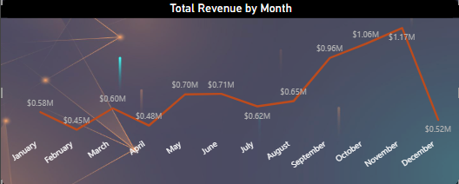
Monthly Revenue Trends
Insight:
- Peak revenue in November ($1.17M)
- Seasonal uptick begins in August
- Drop in December likely due to order cutoffs

Slide 6
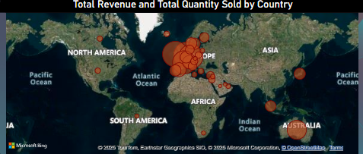
Global Market Demand
Insight:
Visual: Map showing Revenue & Quantity by Country (Excluding UK)
Insight:
High demand in Netherlands, Germany, France
Strategic potential for expansion

Slide 7
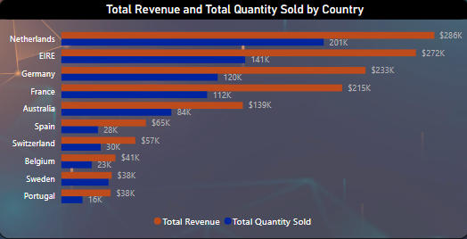
Top Performing Countries
Visual: Bar chart of Total Revenue & Total Quantity by Country
Insight:
Netherlands leads with $286K revenue & 201K units
France & Germany show solid balance of volume & value

Slide 8
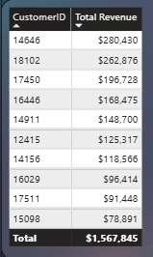
Top 10 Customers by Revenue
Visual: Table or Column chart sorted by revenue (descending)
Insight:
Customer 14646 leads with $280K
Top 10 generate over $1.56M combined
Opportunity for loyalty & retention campaigns

Slide 9
Insights & Conclusion
Capitalize on Q4 seasonality with marketing campaigns
Expand in countries with proven revenue potential
Build loyalty programs for top 10 customers
Further analysis on product category performance & returns

Slide 10
THANK YOU

